Slide 1
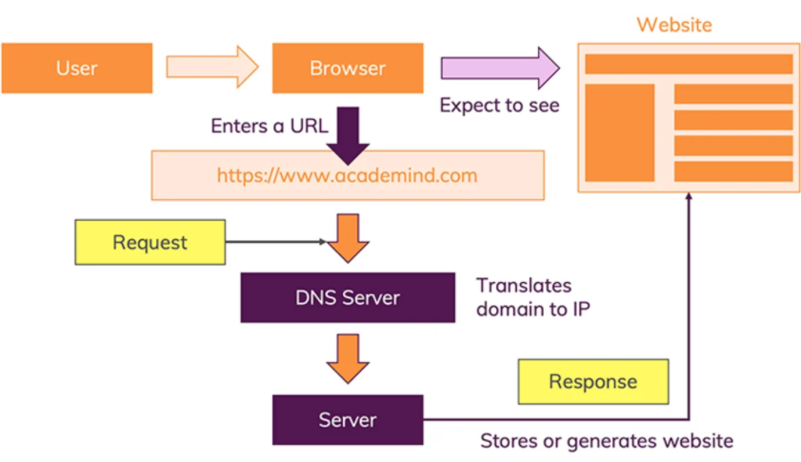
How does the web work?
The moment we enter an address in our browser and we hit ENTER, a lot of different things happen:
The URL gets resolved
A Request is sent to the server of the website
The response of the server is parsed
The page is rendered and displayed

Slide 2

What do you need to be a web developer?
To become a web developer, you'll need a variety of hard and soft skills to succeed. Here are some of the most common skills to have in this role:
HTML/CSS skills
Analytical skills
Responsive design skills
JavaScript skills
Interpersonal skills
Testing and debugging skills
Back-end basics
Search engine optimization

Slide 3

What is the role of a web developer?
A web developer is responsible for programming the code that “tells” a website how to function. A developer builds a website from the bottom up, which means designing it in such a way that end users have no difficulty navigating the site.

